Slide 1
Image Processing
Topic- Count Objects in photo and
segment selected object

Slide 2
01
IDENTIFICATION OF OBJECTS AND LABLES
Techniques and models we have used to perform this.
02
COUNT OBJECTS BASED ON SIMILAR LABLES
CONTENTS
Grouping the objects with different labels.
03
SEGMENTING THE SELECTED OBJECT FROM PHOTO
Techniques and models used for segmentation.
04
RESULTS
Multiple results from the produced model.

Slide 3
1
IDENTIFICATION OF OBJECTS AND LABLES
Used Yolo Model , Highly used for Object Identification , Faster than other models like R-CNN , Fast-RCNN , etc.
Architecture - 22 Convolution Layers and 2 Fully connected layers.
Model Trained with COCO DATASET (90 Classes of objects) .
Trained for 500 epochs .
Implemented using cvlib library detect_common_objects.

Slide 4
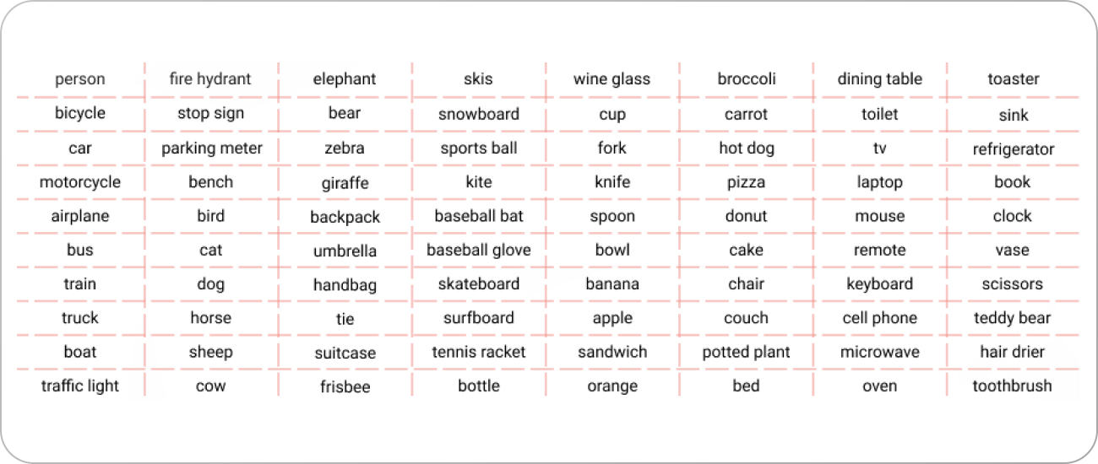
1
IDENTIFICATION OF OBJECTS AND LABLES
.
90 Classes of COCO Dataset , which is used for training the model

Slide 5
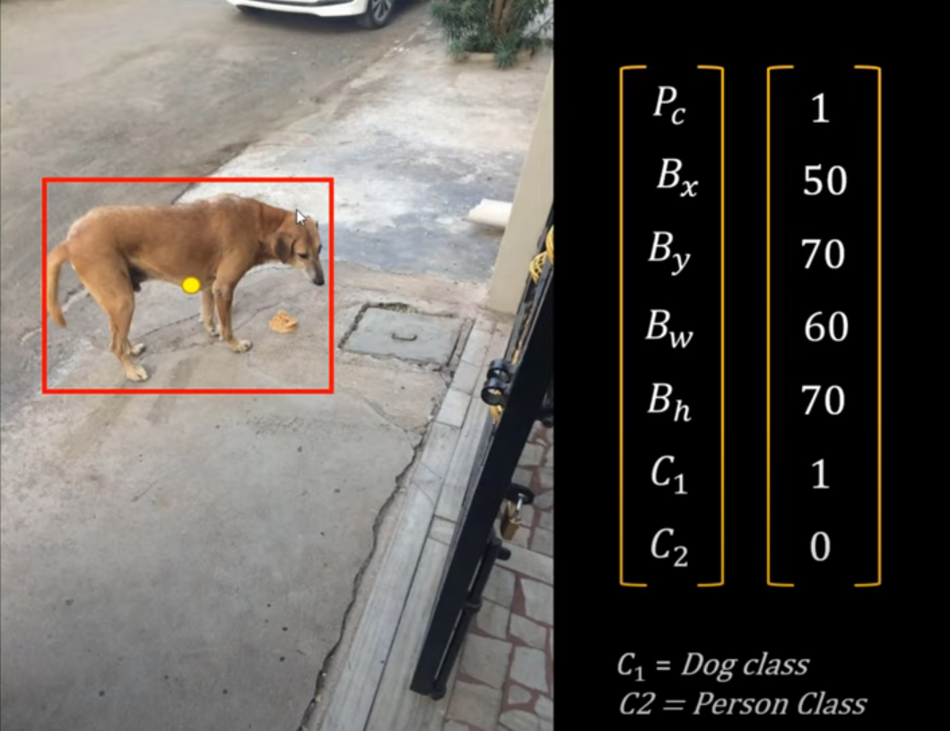
1
IDENTIFICATION OF OBJECTS AND LABLES
.
Pc- Probability of object being present
Bx - x coordinate of the box
By - y coordinate of the box
Bw - width of the box
Bh - height of the box
C1 , C2 .... = Classes in the model and probablity of being in that class

Slide 6
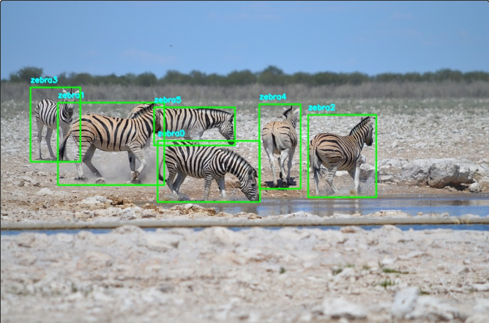
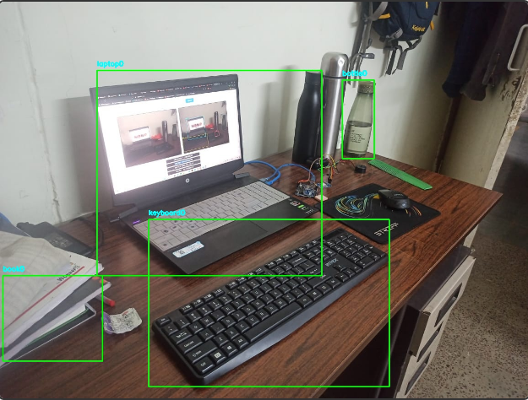
1
IDENTIFICATION OF OBJECTS AND LABLES
.

Slide 7
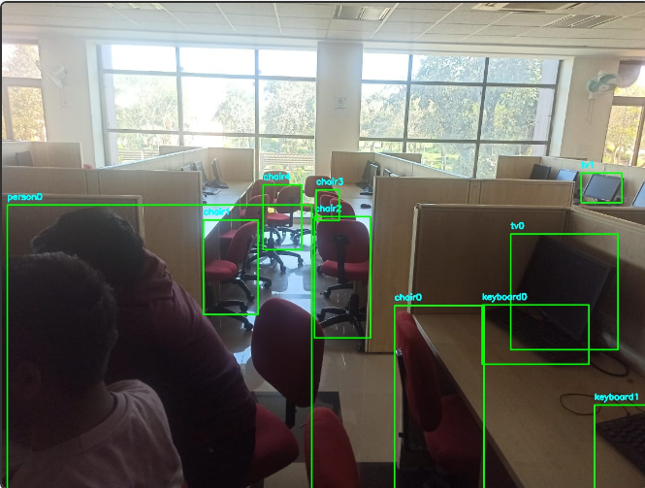
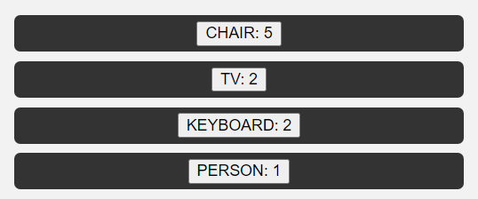
2
COUNT OBJECTS BASED ON SIMILAR LABLES
Classified objects in a dictionary based on the labels , similar objects in one and different in others.
Total Count of each similar objects can be seen.

Slide 8
3
SEGMENTING THE SELECTED OBJECT FROM PHOTO
Used SAM (Segment Anything Model) created by Meta AI trained over SA-1B Dataset containing more than 11M+ Image and 1B+ Masks.
This model Identifies the different segments in a photo and draws them different colors.
We then provide the box location of the object we want to be segmented.
Based on the box location , object which is present in that area will be considered .
Other than the object in the box ,we will mask other part of the image with 0.
Object Seprated from photo will be displayed , with black background.

Slide 9
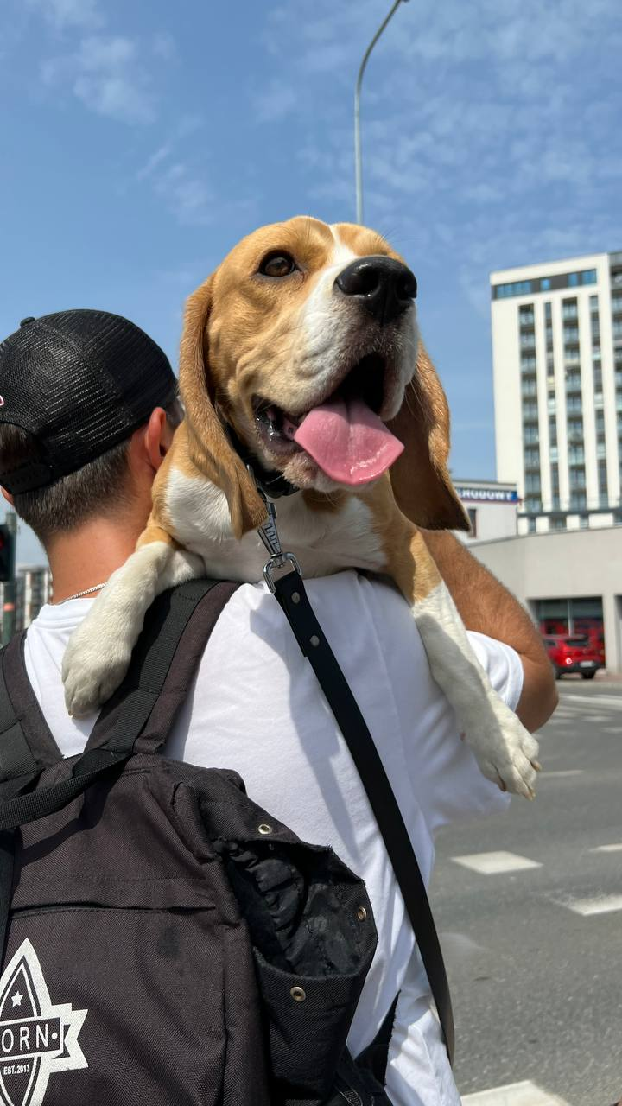
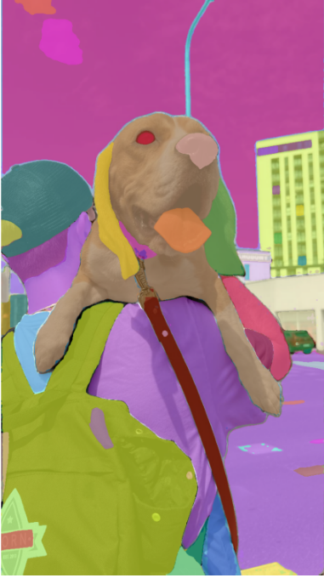
3
1. Input Image
2. Segmented Image From SAM
Enter title
This Template Is Designed By Zuo An,It Will Help You Make You Report Easy And Fast.

Slide 10
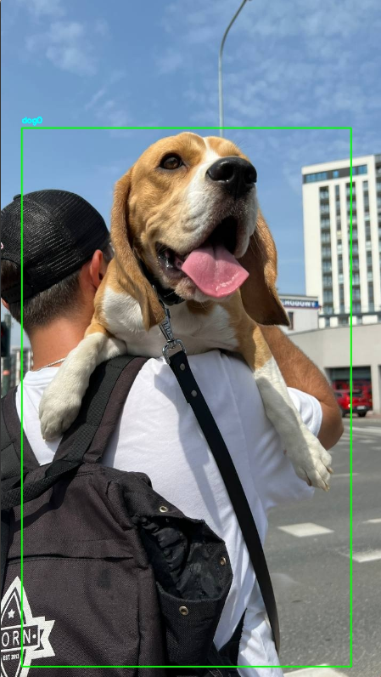

3
3. Box around the object
4. Segmented Dog object
Applied 0 mask on the background part of the image and 1 mask on the most highlighted part in the box according to the segmented Image
Enter title
This Template Is Designed By Zuo An,It Will Help You Make You Report Easy And Fast.

Slide 11
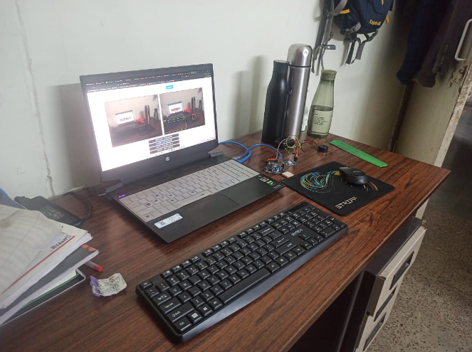
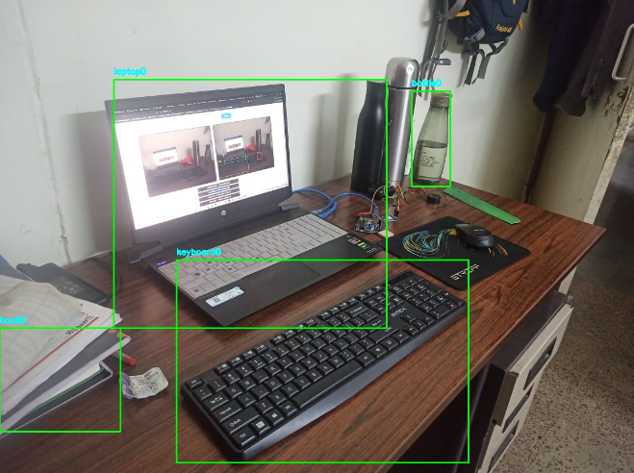
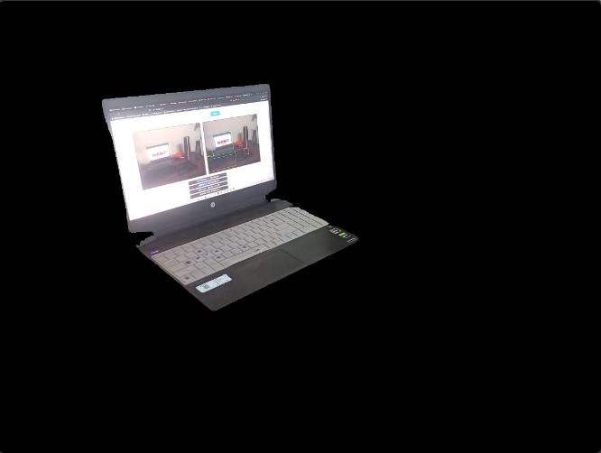
4
RESULTS
1. Input Image
2. Box around the Laptop object selected
3. Segmented Laptop object
Enter title
This Template Is Designed By Zuo An,It Will Help You Make You Report Easy And Fast.

Slide 12
THANK YOU
Prepared By -
Divyanshu Sharma (21BCS079)
Deepranjan Kumar (21BCS074)

